Slide 1
IBM University Engagement Project Submission
“Exploring the Power of Agentic AI with IBM Granite and LangFlow”

Slide 2

Project Tile – CareerCompass – AI Career Guidance Assistant
Domain of Project – Education
Student Name | Recent Passport Photo | Email ID | Mobile number [WhatsApp]
Vedant More |  | vedantbmore@gmail.com | +91 9987151427

Slide 3
Problem Statement -
Problem Statement : Career Guide
The Challenge
Choosing the right career is one of the biggest challenges faced by students after Class 10, Class 12, or graduation. Many students are unsure about which course matches their interests, skills, or future goals. Although information is available on the internet, it is often scattered across different websites, making it difficult to understand and compare options.
Professional career counselling is not affordable or easily accessible for everyone. Because of this, many students end up making decisions based on incomplete information or advice from others.
The goal of this project is to provide students with a simple AI-powered assistant that can answer career-related questions instantly and guide them toward suitable educational and career paths.

Slide 4
Proposed Solution -
Proposed Solution: AI-Powered Guidance Assistant
To solve this problem, I developed CareerCompass, an AI-powered career guidance assistant using IBM watsonx Assistant.
The assistant interacts with users in a conversational way and provides guidance based on their questions. It can explain different career options, suggest suitable courses, describe required skills, and answer common career-related doubts.
The assistant is integrated into a responsive website, allowing users to access it easily from their browser without installing any application.
The main objective of the project is to make career guidance simple, accessible, and available anytime for students.

Slide 5
Technology Used
IBM watsonx Assistant – Used to build the AI chatbot that understands user questions and provides career guidance.
IBM Granite Foundation Model - Used to generate accurate, natural, and meaningful responses for users.
HTML5 - Used to create the basic structure and content of the website.
CSS3 - Used to design the website and make it visually attractive and responsive.
JavaScript - Used to add interactivity and connect the website with the AI assistant.
GitHub Pages - Used to host the website online so anyone can access it through a web browser.
Visual Studio Code - Used as the code editor to develop, test, and manage the project files.
BOB (from IBM) – Used to dynamically generate a stunning website within VS Code

Slide 6
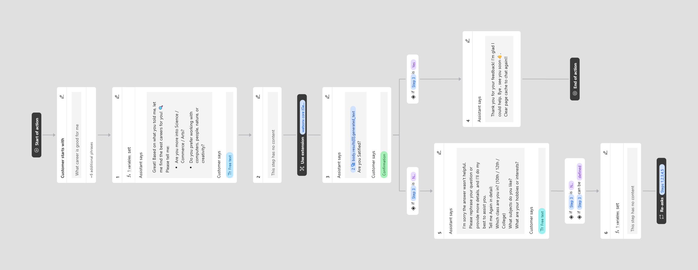
IBM watsonx Assistant Workflow-
Tilt for clarity

Slide 7
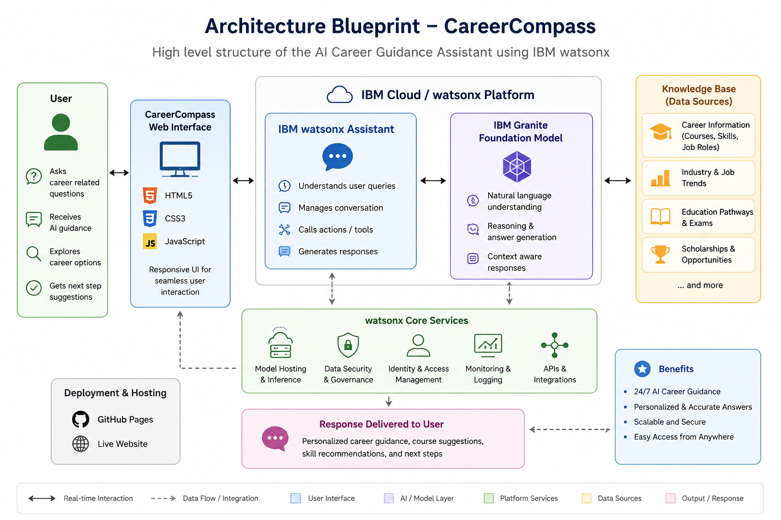
Architecture blueprint
Visualized by AI

Slide 8

Role of AI in the solution
Foundation Model to provide intelligent career guidance through natural language conversations. Instead of relying on fixed answers, the assistant understands the user's questions and generates responses based on the context of the conversation.
The AI helps students explore suitable career options, understand different courses, learn about required skills, and receive step-by-step guidance based on their interests. It can answer follow-up questions, explain concepts in simple language, and provide quick information without requiring users to search through multiple websites.
Since the assistant is available online, students can access career guidance anytime through the web interface. This makes the system easy to use, accessible, and capable of providing consistent support whenever needed.

Slide 9
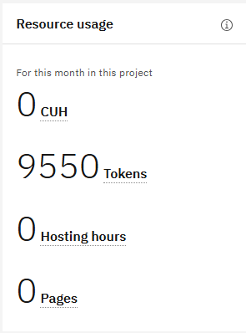
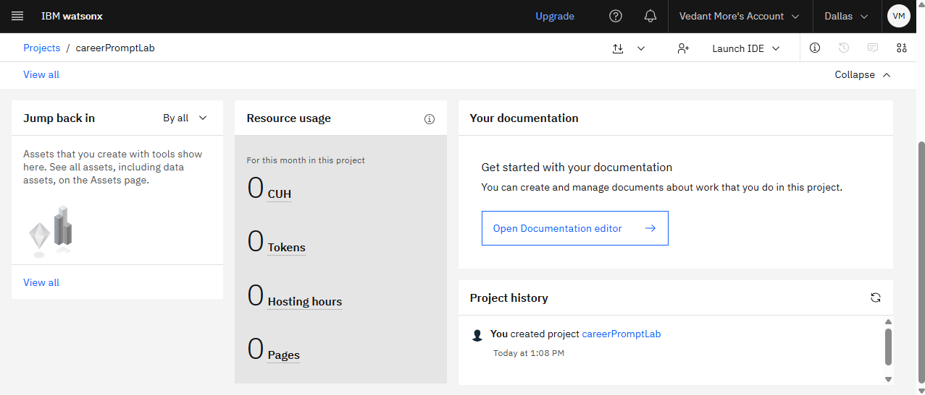
Token Usage
9550 token are used (on first attempt , may be more after multiple test)
Before Prompt
After the Prompt
·
·
·

Slide 10
Novelty and Uniqueness
CareerCompass is designed to make career guidance simple, accessible, and available to every student through an AI-powered web assistant. Unlike searching across multiple websites, users can ask questions in natural language and receive clear, personalized responses in a single conversation.
The project combines IBM watsonx Assistant with the IBM Granite Foundation Model to create a smooth conversational experience. It is integrated into a responsive website, allowing users to access career guidance directly from any modern web browser without installing additional software.
Key Highlights
Provides instant career guidance through an AI-powered conversational interface.
Uses IBM Granite to generate clear and context-aware responses.
Simple and user-friendly website that is easy to access from any device.
Saves time by bringing career information into one place instead of multiple websites.
Can be expanded in the future with aptitude tests, college recommendations, resume building, interview preparation, and multilingual support.
Built using modern IBM AI technologies, making the solution scalable and easy to enhance with additional features.

Slide 11
Git Hub Link
Repo Link : GITHUB REPO LINK
Files Structure:
index.html
README.md
Project Presentation.pptx
ProblemStatement.pdf
·
·
·

Slide 12
Future Scope
CareerCompass can be enhanced with several new features to provide even better career guidance. Future versions may include AI-based aptitude tests, personalized college and course recommendations, resume and interview preparation, scholarship information, and support for multiple Indian languages. The assistant can also be integrated with student profiles to provide more personalized suggestions and track career planning progress over time.
·
·
·

Slide 13
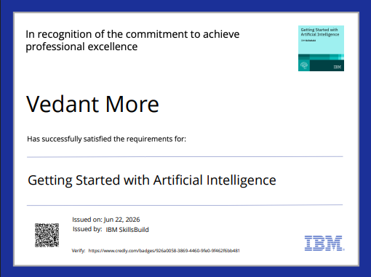
Certificates Earned:

Slide 14
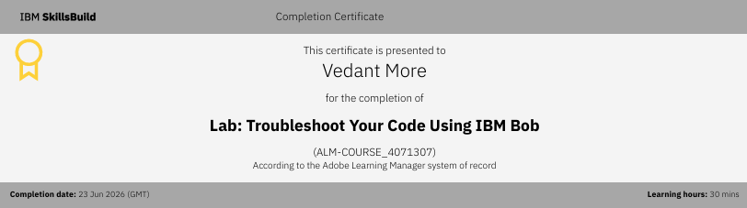
Certificates Earned:​

Slide 15


